Slide 1
Local Library Analysis
Exploratory Data Analysis of Oregon Library Dataset

Slide 2
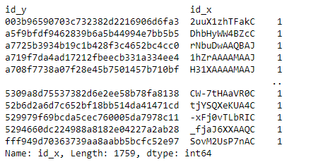
Analyzing how often a patron checks out from the library
Notes:
From the table above, we notice that the customers that have borrowed books have only checked out once in the library and since each customer has only checked out once, there isn't a patron with a higher frequency of late returns.

Slide 3
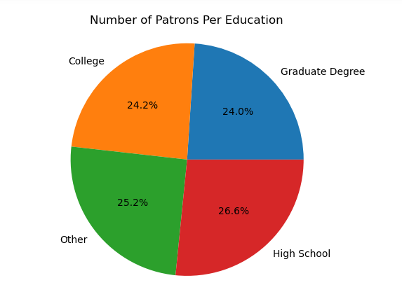
Analyzing number of patron per education category
Notes:
The chart shows the percentage of patrons in each education category. We cn conclude that they are almost evenly distributed.

Slide 4
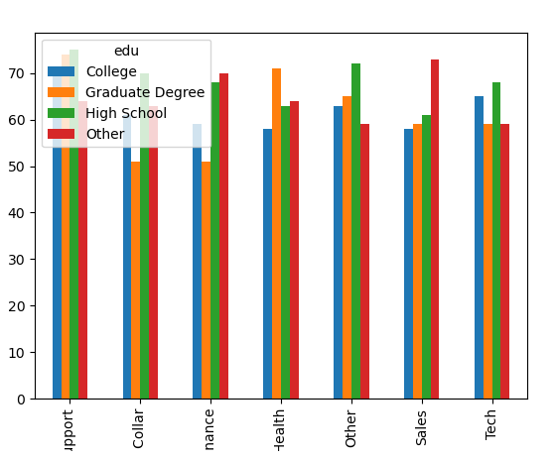
Analyzing number of patron per education category
Notes:
This chart includes the occupation of the patron along with their education level

Slide 5
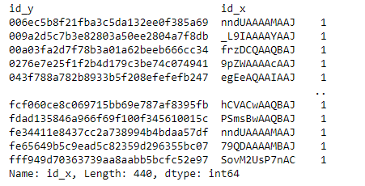
Analyzing the total number of late returns in the library
Notes:
We can see from the table above the length of the dataset, this shows that we have the total number of 440 late returns in the library and since we’ve analysed that each patron has checked out a book only once, it’s right to conclude that 440 patrons returned books late.

Slide 6
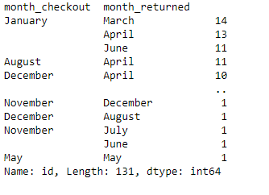
Analyzing months where books with late returns are borrowed most
Notes:
From the table above, it is obvious that where late-returned books were borrowed most was January. Patrons may not be able to return the books within the allocated period for so many reasons whether personal or reasons that may be out of their control like terrible weather since the coldest month in Oregon is January. We can see that most books borrowed in January were lately returned in March, this can be due to the slightly warmer weather or the holidays.

Slide 7
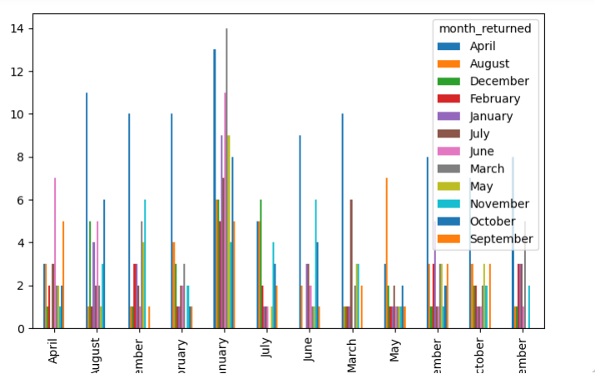
Analyzing months where books with late returns are borrowed most
Notes:
A bar chart visualising the analysis of months where books with late returns are borrowed most

Slide 8
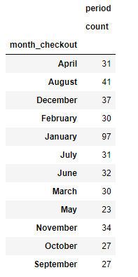
Number of books borrowed each month that turned out to be returned late
Notes:
The table shows the number of books that are borrowed each month and turned out to be returned later in the year. Like the previous slide, January has the highest number of books borrowed that ended up being returned late.

Slide 9
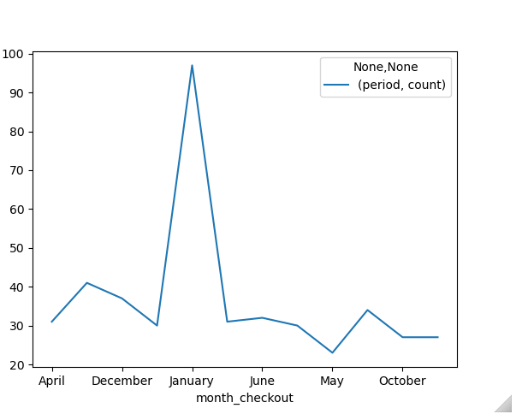
Number of books borrowed each month that turned out to be returned late
Notes:
Using a line chart to visualize the number of books borrowed each month where the return period is late.

Slide 10
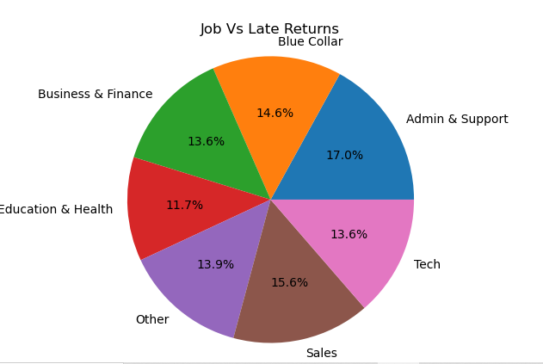
Analyzing how occupation of the patron factor into their late returns
Notes:
This shows that patrons that work in Admin & Support have the highest late returns rate.

Slide 11
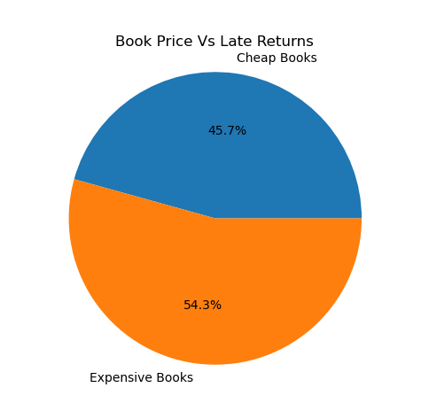
Analyzing how the price of the books factor into their late returns
Notes:
Expensive books have higher rate of late returns than cheaper books

Slide 12
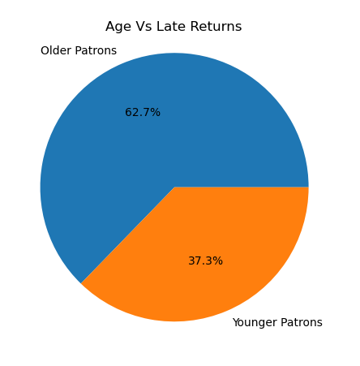
Analyzing how the age of patrons factor into their late returns
Notes:
Older patrons(40 years and above) have higher rate of late returns than younger patrons.

Slide 13
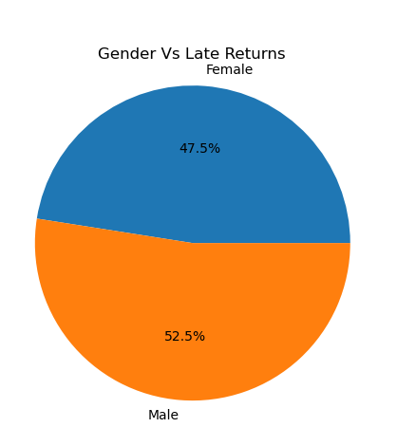
Analyzing how the gender of patrons factor into their late returns
Notes:
Men have higher rate of late returns than women do.

Slide 14
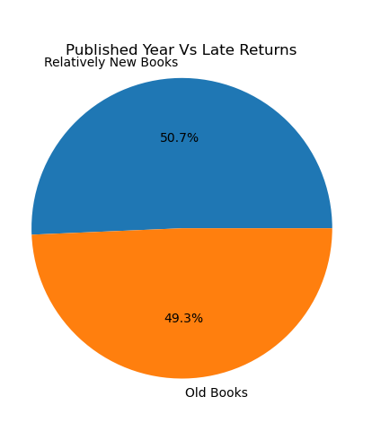
Analyzing how the published year of the books factor into their late returns
Notes:
New books have a little higher rate of late returns than older books.

Slide 15
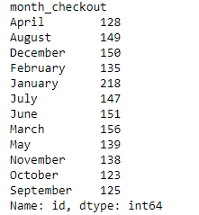
Analyzing the number of borrowed books each month
Notes:
Again, January has the highest number of books borrowed in a month. The reason could be that most patrons want to begin their year with a new hobby.

Slide 16
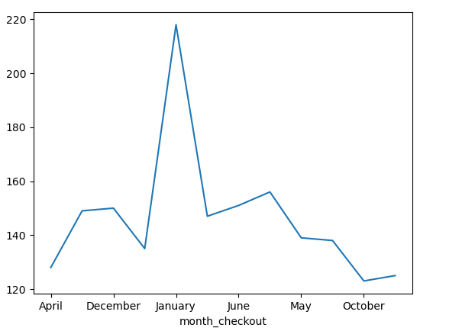
Analyzing the number of borrowed books each month
Notes:
Visualising the result will a line chart will help us understand the activities in the library all through the year in terms of book checkout.

Slide 17
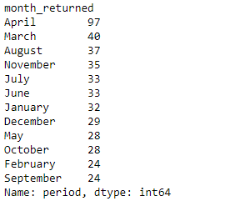
Analyzing number of late returns the library gets per month
Notes:
The numbers agave been sorted so we can easily spot months most overdue books are returned to the library. The best explanation to why books have higher returns in April is the Spring weather.

Slide 18
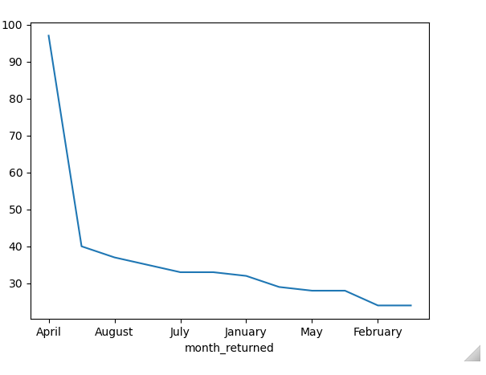
Analyzing number of late returns the library gets per month
Notes:
Line chart is used to depict the number of late returns per month.

Slide 19
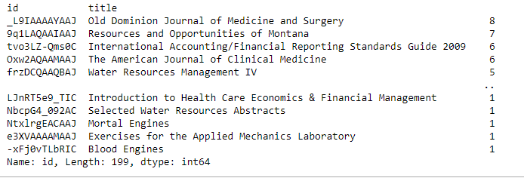
Analyzing the number of times a book has been returned late
Notes:
The book that has the highest number of late returns according to the table above is a book on Medicine and Surgery

Slide 20
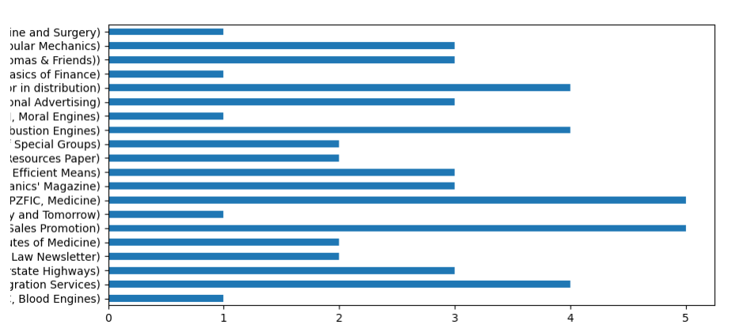
Analyzing the number of times a book has been returned late
Notes:
The visualisation of the number of times a book has been returned late is represented in an horizontal bar chart

Slide 21
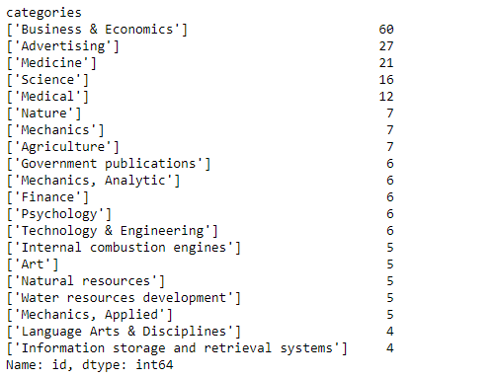
Analyzing the book category with most late returns
Notes:
The book category with most late returns from the table above is Business & Economics.

Slide 22
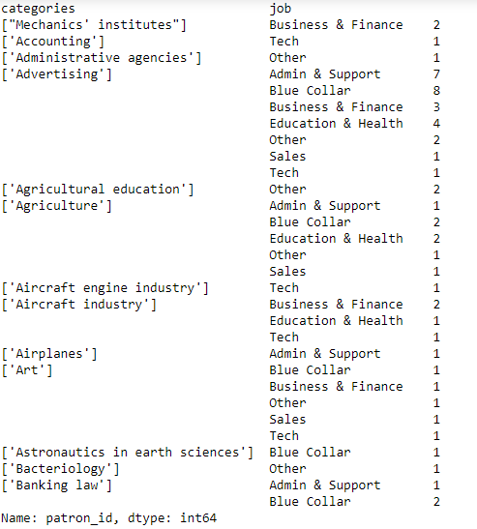
Occupation of patrons that have late returns in each book category
Notes:
The table above gives us the number of patrons in each occupation category that have late returns in each book category. It shows us how a book checked out by a patron could relate to the patron’s occupation

Slide 23
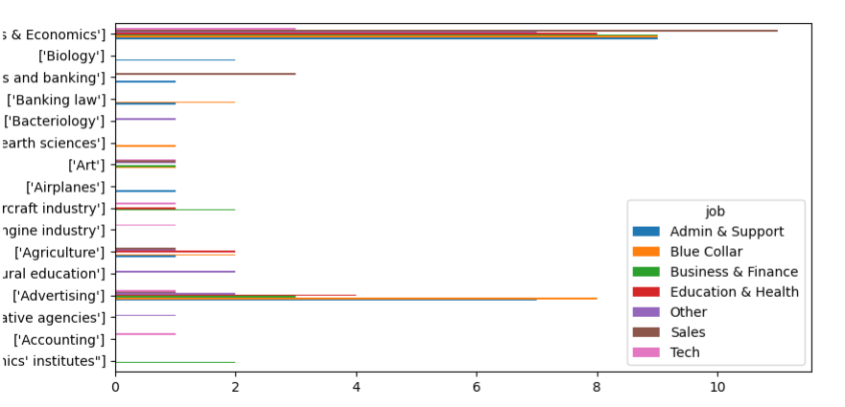
Occupation of patrons that have late returns in each book category
Notes:
The chart visualizes the unstacked dataset.

Slide 24
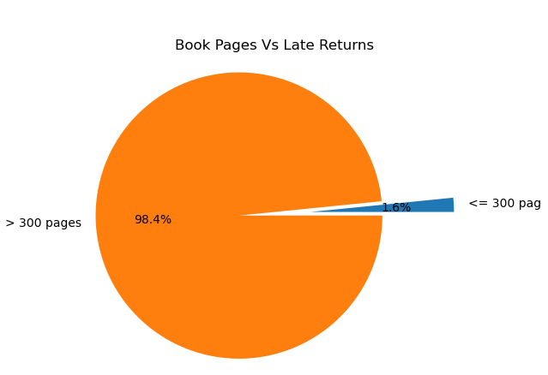
How does the book pages relate with late returns of the book
Notes:
The pie chart shows that 98.4% of books are returned late because they have more than 300 pages. Book page is a big variable when dealing with late returns of books.

Slide 26
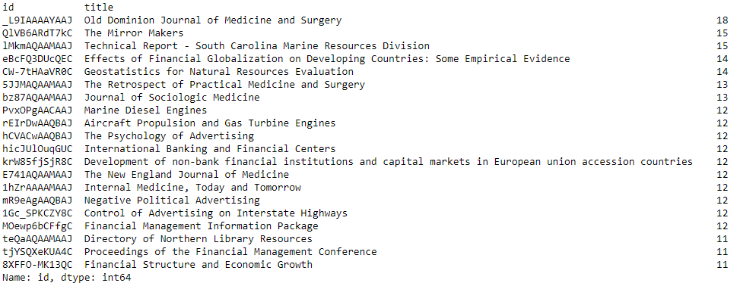
Analyzing most checked out book in the library
Notes:
Comparing the previous analysis to this, we notice that the most checked out book is also the book that has most late returns with the only difference being that 10 patrons return the book within the allotted period.

Slide 27
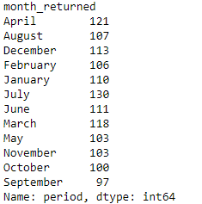
Analyzing the number of books returned within the due date each month

Slide 28
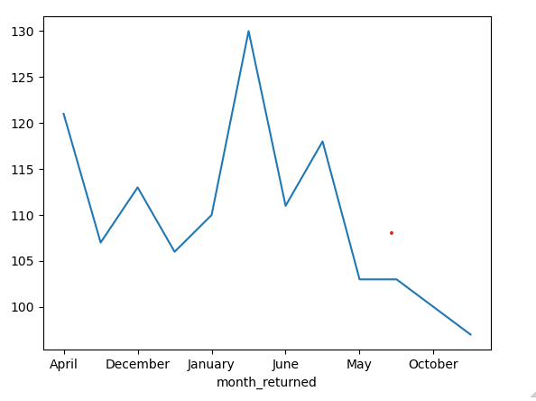
Analyzing the number of books returned within the due date each month
Notes:
A line chart visualising the trends of book returned within the due date across the months of the year

Slide 29
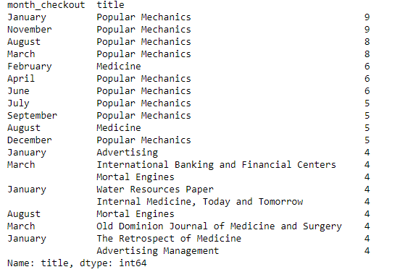
Analyzing the most Checked out book in a month
Notes:
Popular Mechanics is a popular book in the library seeing as it is the most checked out book in 9 different months.

